Slide 1
TRADITIONAL METHODS VS LATEST MATHODS BY:SOWMIYA SIVAKUMAR

Slide 2
TRADITIONAL METHODOLOGIES
Definition: Traditional methodologies follow a linear and sequential approach to project management.
Objective: Deliver a project within a predetermined scope, time, and budget

Slide 3
Process
Waterfall model: Requirements gathering, design, implementation, testing, and deployment
Waterfall Model Diagram
Requirements → Design → Implementation → Testing → Deployment.
Emphasis on planning, documentation, and predictability.

Slide 4
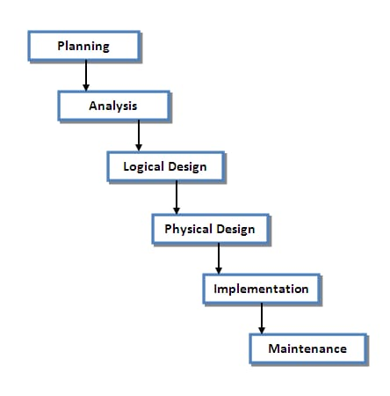
PROCESS DIAGRAM

Slide 5
Advantages and Disadvantages
Advantages: Predictable timeline, clear scope, and well-defined deliverables.
Disadvantages: Inflexible, resistant to change, and high risk of project failure if requirements change.

Slide 6
Drawbacks
Limited stakeholder involvement, lack of flexibility, and high risk of project failure

Slide 7
Latest Methodologies (Agile)
Definition: Agile methodologies follow an iterative and incremental approach to project management.
Objective: Deliver a working product in short cycles, with continuous improvement and flexibility.

Slide 8
Process
Iterative development, continuous integration, and delivery.
Iteration 1: Plan → Develop → Test → Review
Iteration 2: Refine → Develop → Test → Review...
Emphasis on collaboration, customer feedback, and adaptability.

Slide 9
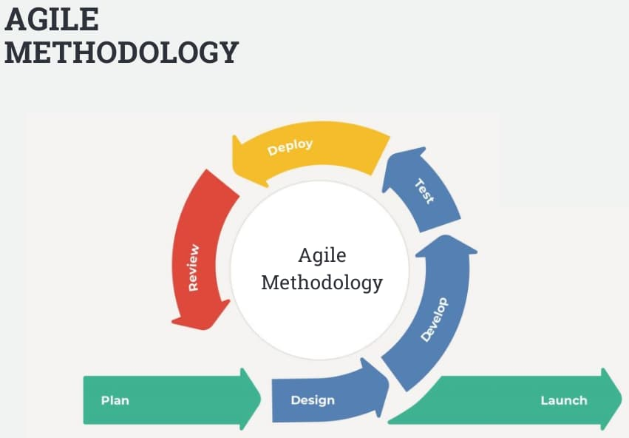
PROCESS DIAGRAM

Slide 10
Advantages
Flexibility, rapid delivery, and continuous improvement.
Improved stakeholder involvement and reduced risk of project failure.
Overcoming Traditional Drawbacks:
Addressing limitations of traditional methodologies by embracing change, encouraging collaboration, and delivering working products in short cycles.

Slide 11
Agile Benefits
Flexibility, rapid delivery, and continuous improvement, addressing limitations of traditional methodologies.

Slide 12
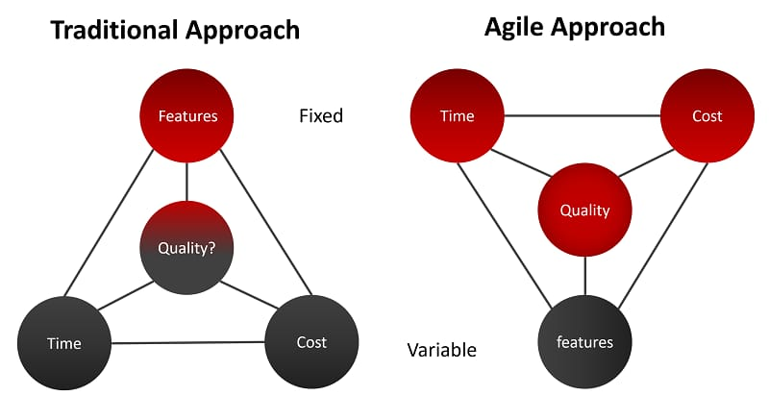
TRADITIONAL APPROACH VS AGILE APPROACH

